Slide 1
ENSE 471, Milestone 2
Hiromi
Brandon Eagan, Kegan Lavoy, Nicolas Achter, Glaiza Regonas
February 6th, 2019

Slide 2
Brainstorm #1
Rationalizing the number of ideations we created
In total, we came up with 9 ideations and presented 6 to the stakeholders. We feel that by focusing on high level design more so than content development we were able to create more ideations and this translated to a higher understanding of the stakeholders desires.
Did we incorporate the “digital constraints”?
In all cases except one we incorporated the digital constraints, we took the approach of designing a non-interactive skin, as Cascade Server is functionally a CMS we wanted to avoid dynamic elements which may require additional work to incorporate into the existing architecture.
Why did we select the lo-fidelity prototype approach for our ideations?
We chose to mockup low fidelity prototypes, again due to our desire to understand the layout required more so than the content. We feel it would have been better to include storyboards as well to walk the stakeholders through use cases.

Slide 3
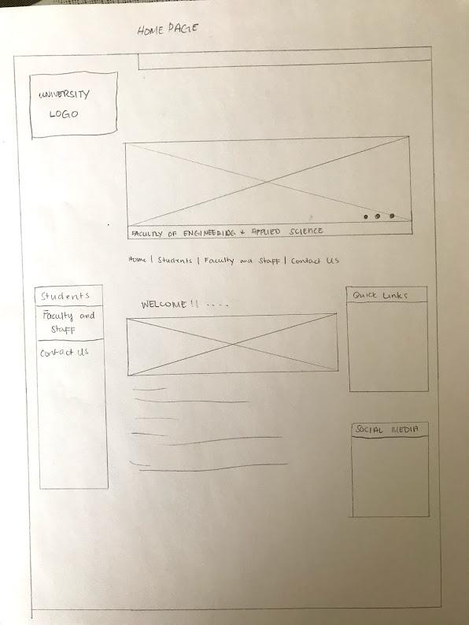
Brainstorm #1 - Ideations

Slide 4
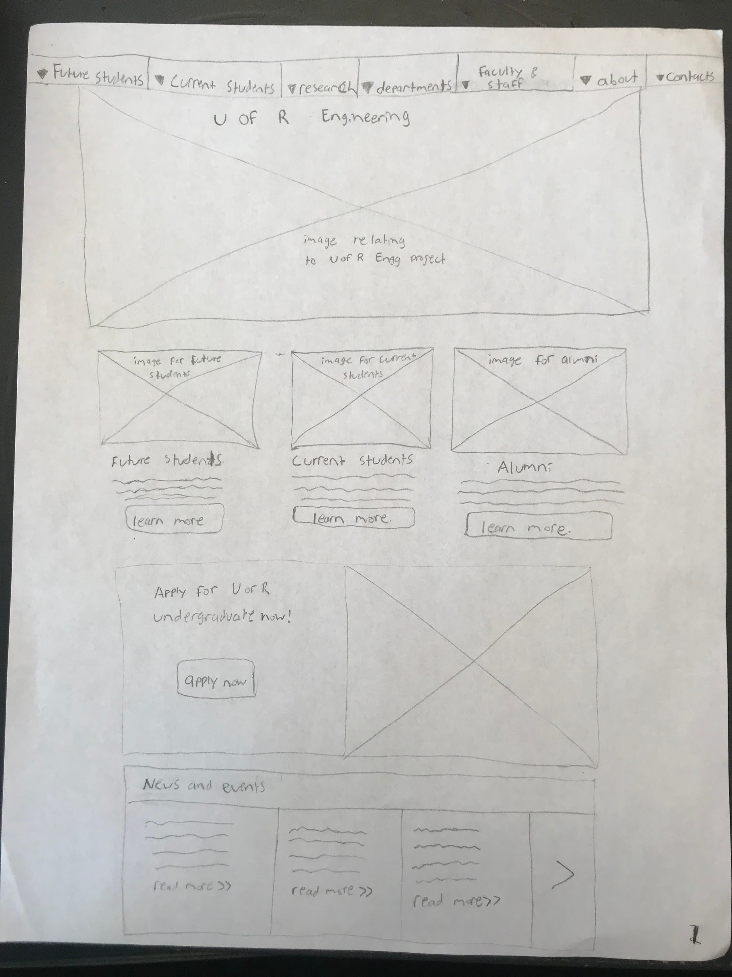
Brainstorm #1 - Ideations

Slide 5
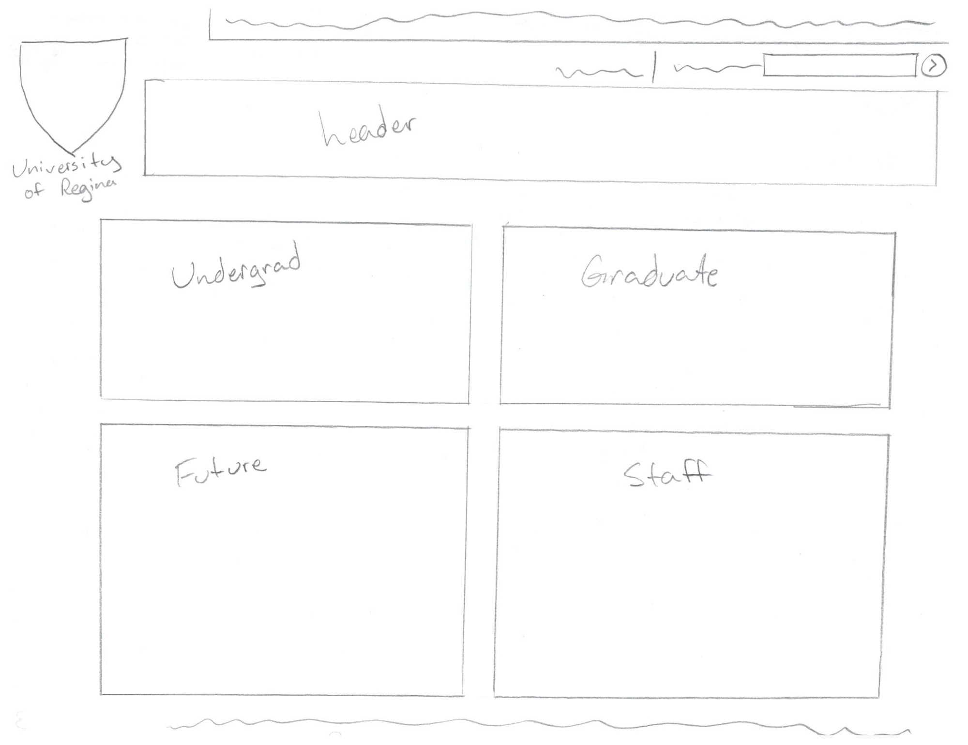
Brainstorm #1 - Ideations

Slide 6
Evaluation
Feedback received on our ideations
Ideation #1: They disliked this one.
Ideation #2: They liked this one, the scrolling new section was nice, be careful with repeating content.
Ideation #3: They disliked this one.
Feedback received/discussion had beyond our ideations
We discussed more on the desirability of social media, the current social media used (there is none), and the management of potential social media.
We also discussed how content is currently managed, and were proposed to come up with a workflow for accompany our design.

Slide 7
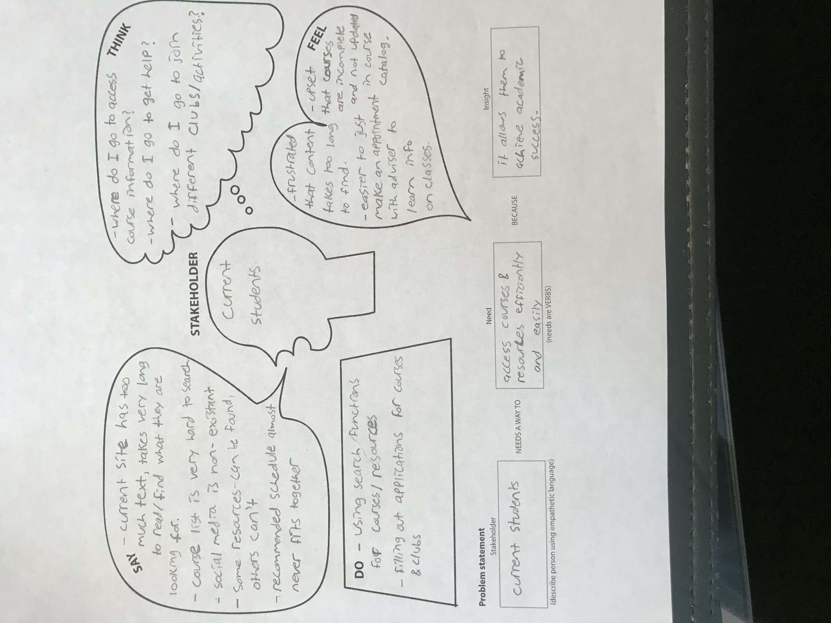
Evaluation (Empathy Maps)

Slide 8
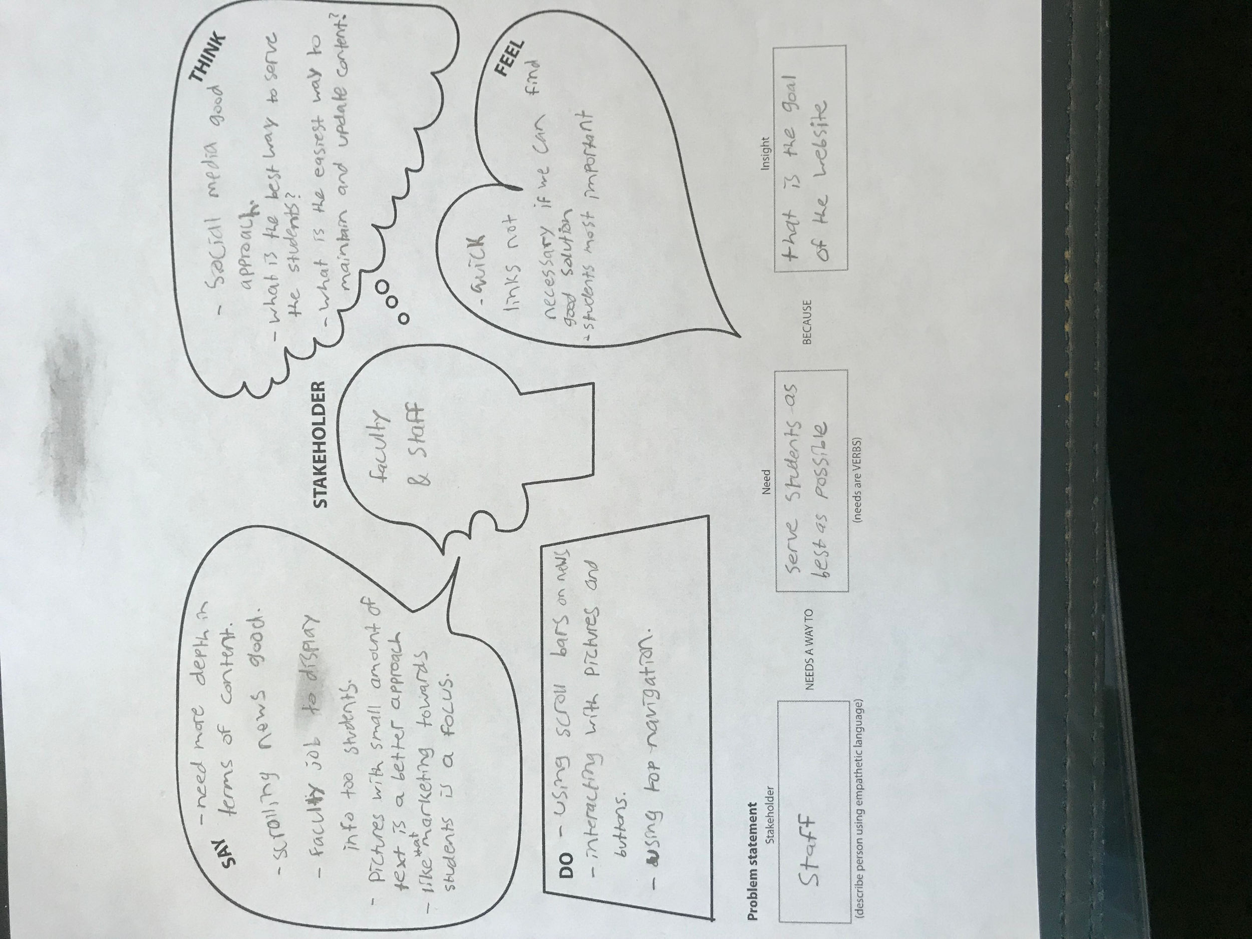
Evaluation (Empathy Maps) cont.

Slide 9
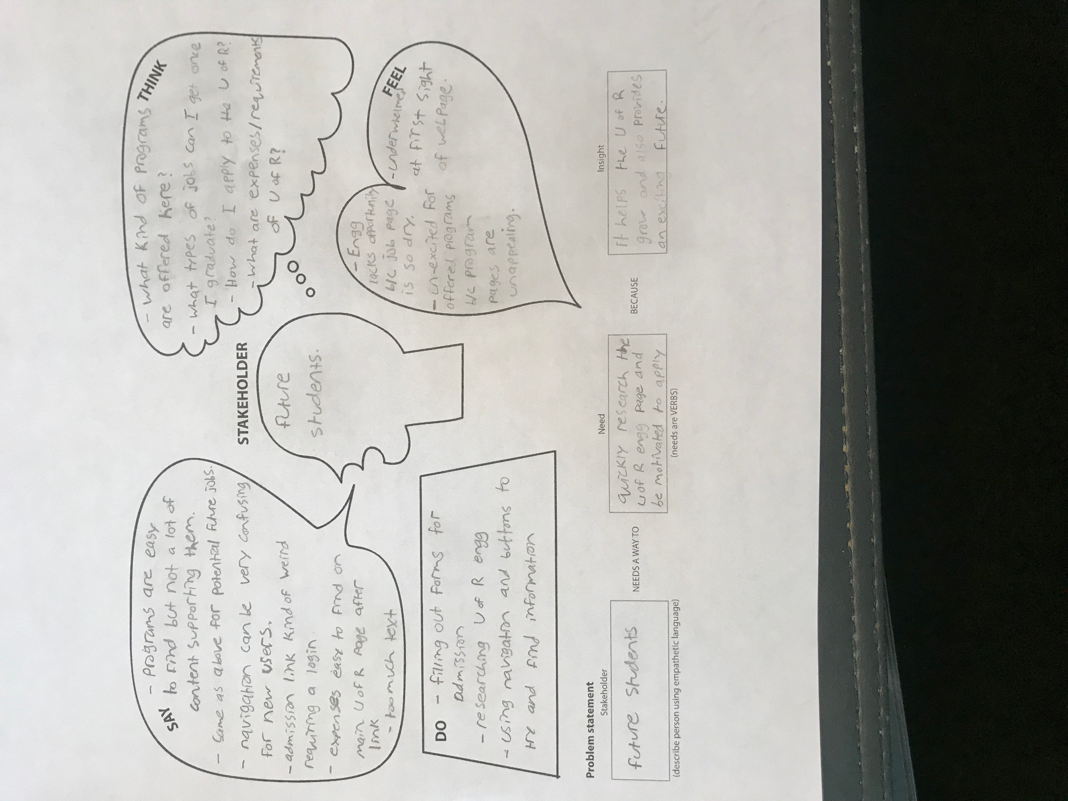
Evaluation (Empathy Maps) cont.

Slide 10
Evaluation
Experience in working with our focus group
Pros
Valuable insight which highlighted where they agreed/disagreed with us.
Gave us a clear direction with which design we should proceed with.
Cons
Still not enough time, more a limitation of the project than anything else.
Everyone kind of took the role of Staff/Faculty despite picking stakeholders to act as.
We didn’t learn much about what they disliked about the designs they didn’t like.

Slide 11
Brainstorm #2 - Ideation Main Page

Slide 12
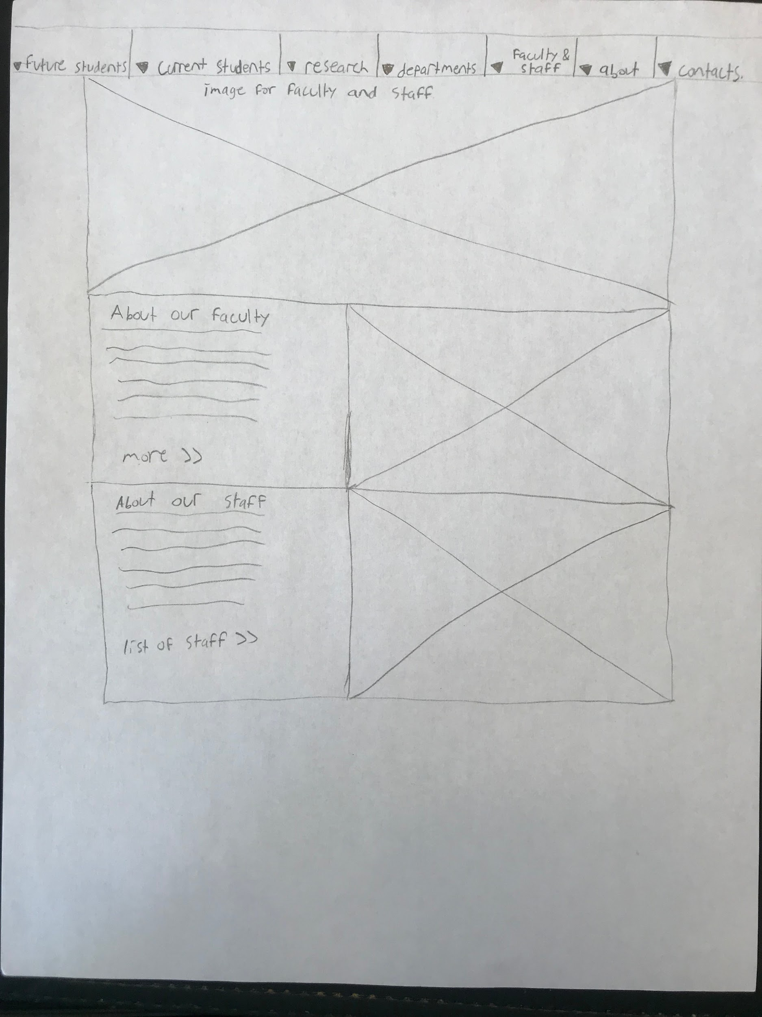
Brainstorm #2 - Ideation Staff Page

Slide 13
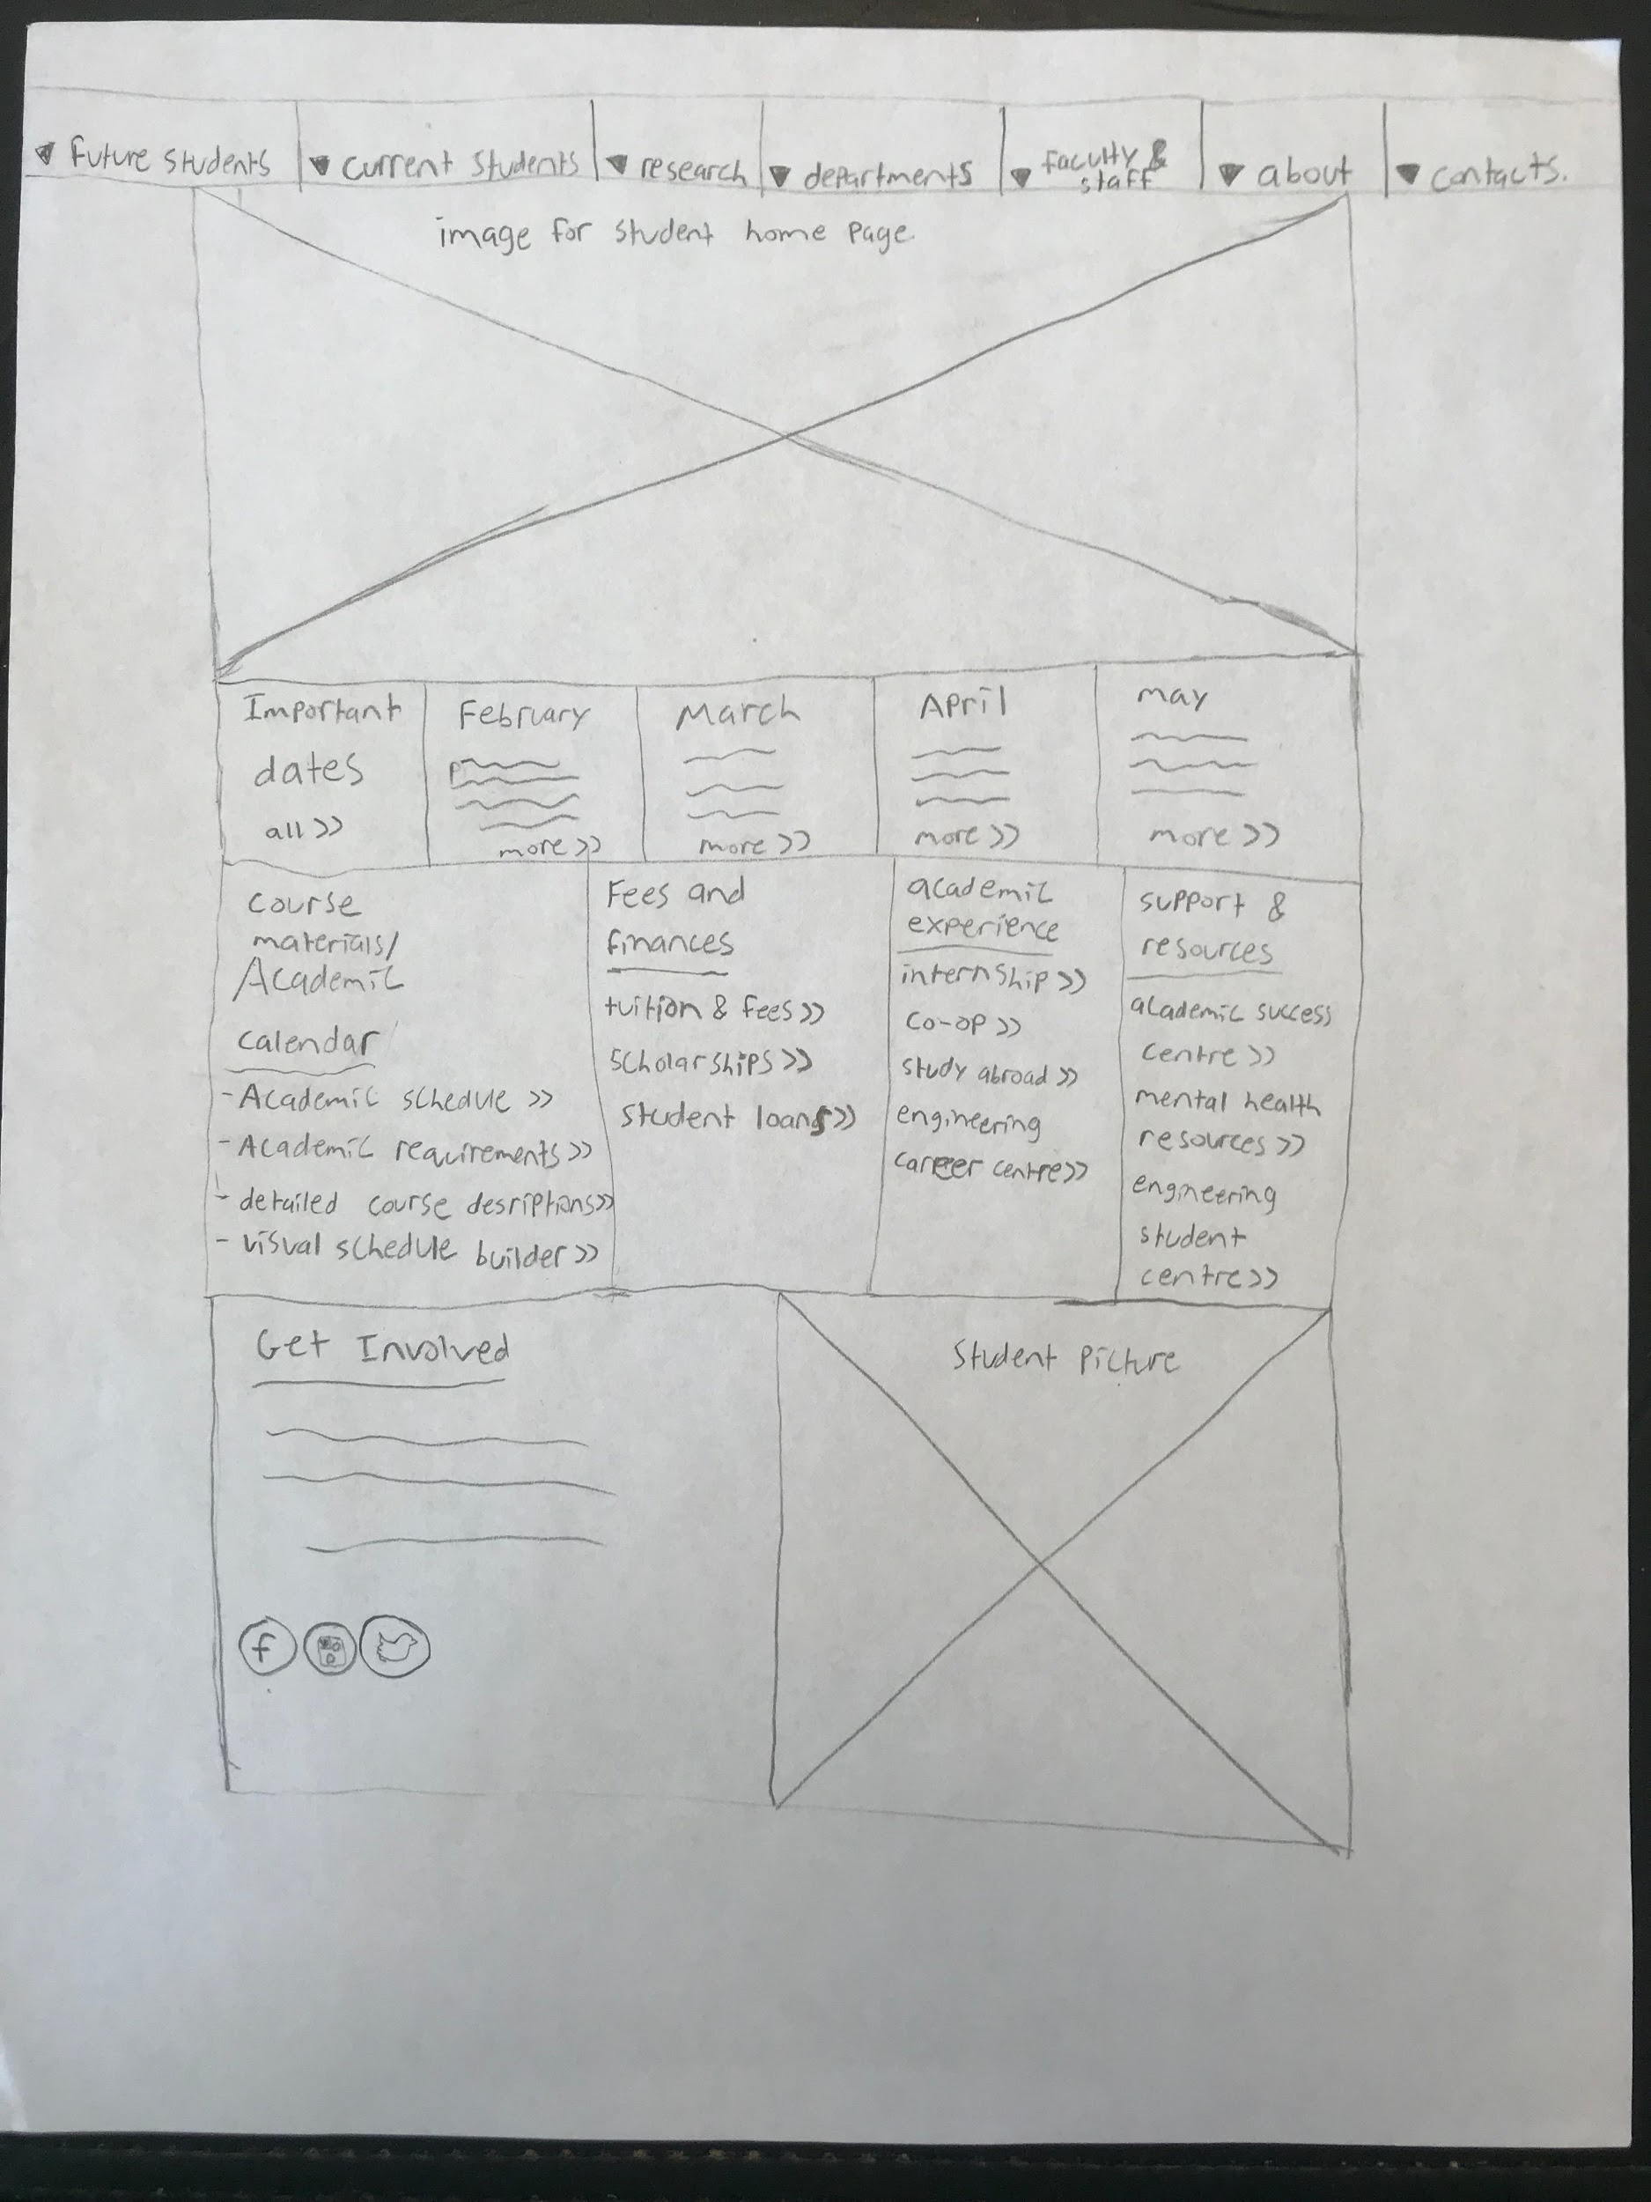
Brainstorm #2 - Ideation Current Student Page

Slide 14
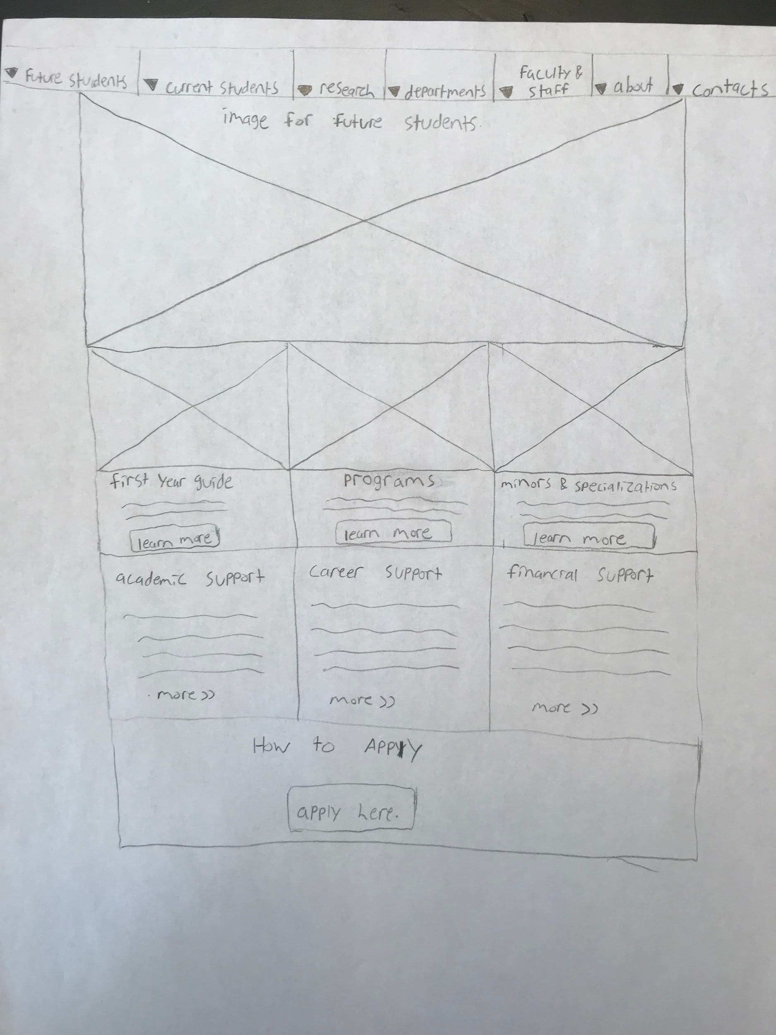
Brainstorm #2 - Ideation Future Student Page

Slide 15
BrainStorm #2: Usability Questions
Faculty and Staff | Current Students | Future Students
How would you locate a fellow profs time table? How would you view pending graduate student applications? Where would you find additional faculty information? How do I find papers published by my colleagues? Where would I find class history? | How would I search and apply for the RESS (Regina Engineering Student Society)? Where would I find the detailed information about ENSE 471? How do I find classes available for Fall 2019? Is the time-conflict form easily located? Where would I find general information about the capstone project? How do I find information about COOP and Internship? How would I set up an appointment for academic advising? How will I know when the capstone project presentation will be? Where would I find jobs (ex. summer job) that is relevant for Software Engineering? Where can I find a detailed class schedules for Software System Engineering (includes prerequisites)? | How would you locate the application form to apply for U of R engineering? How to locate offered programs and potential career options? How to view and understand the program’s course schedules? How to learn about the class details for a specific class? Where would you go to view requirements and living expenses related to engineering?

Slide 16
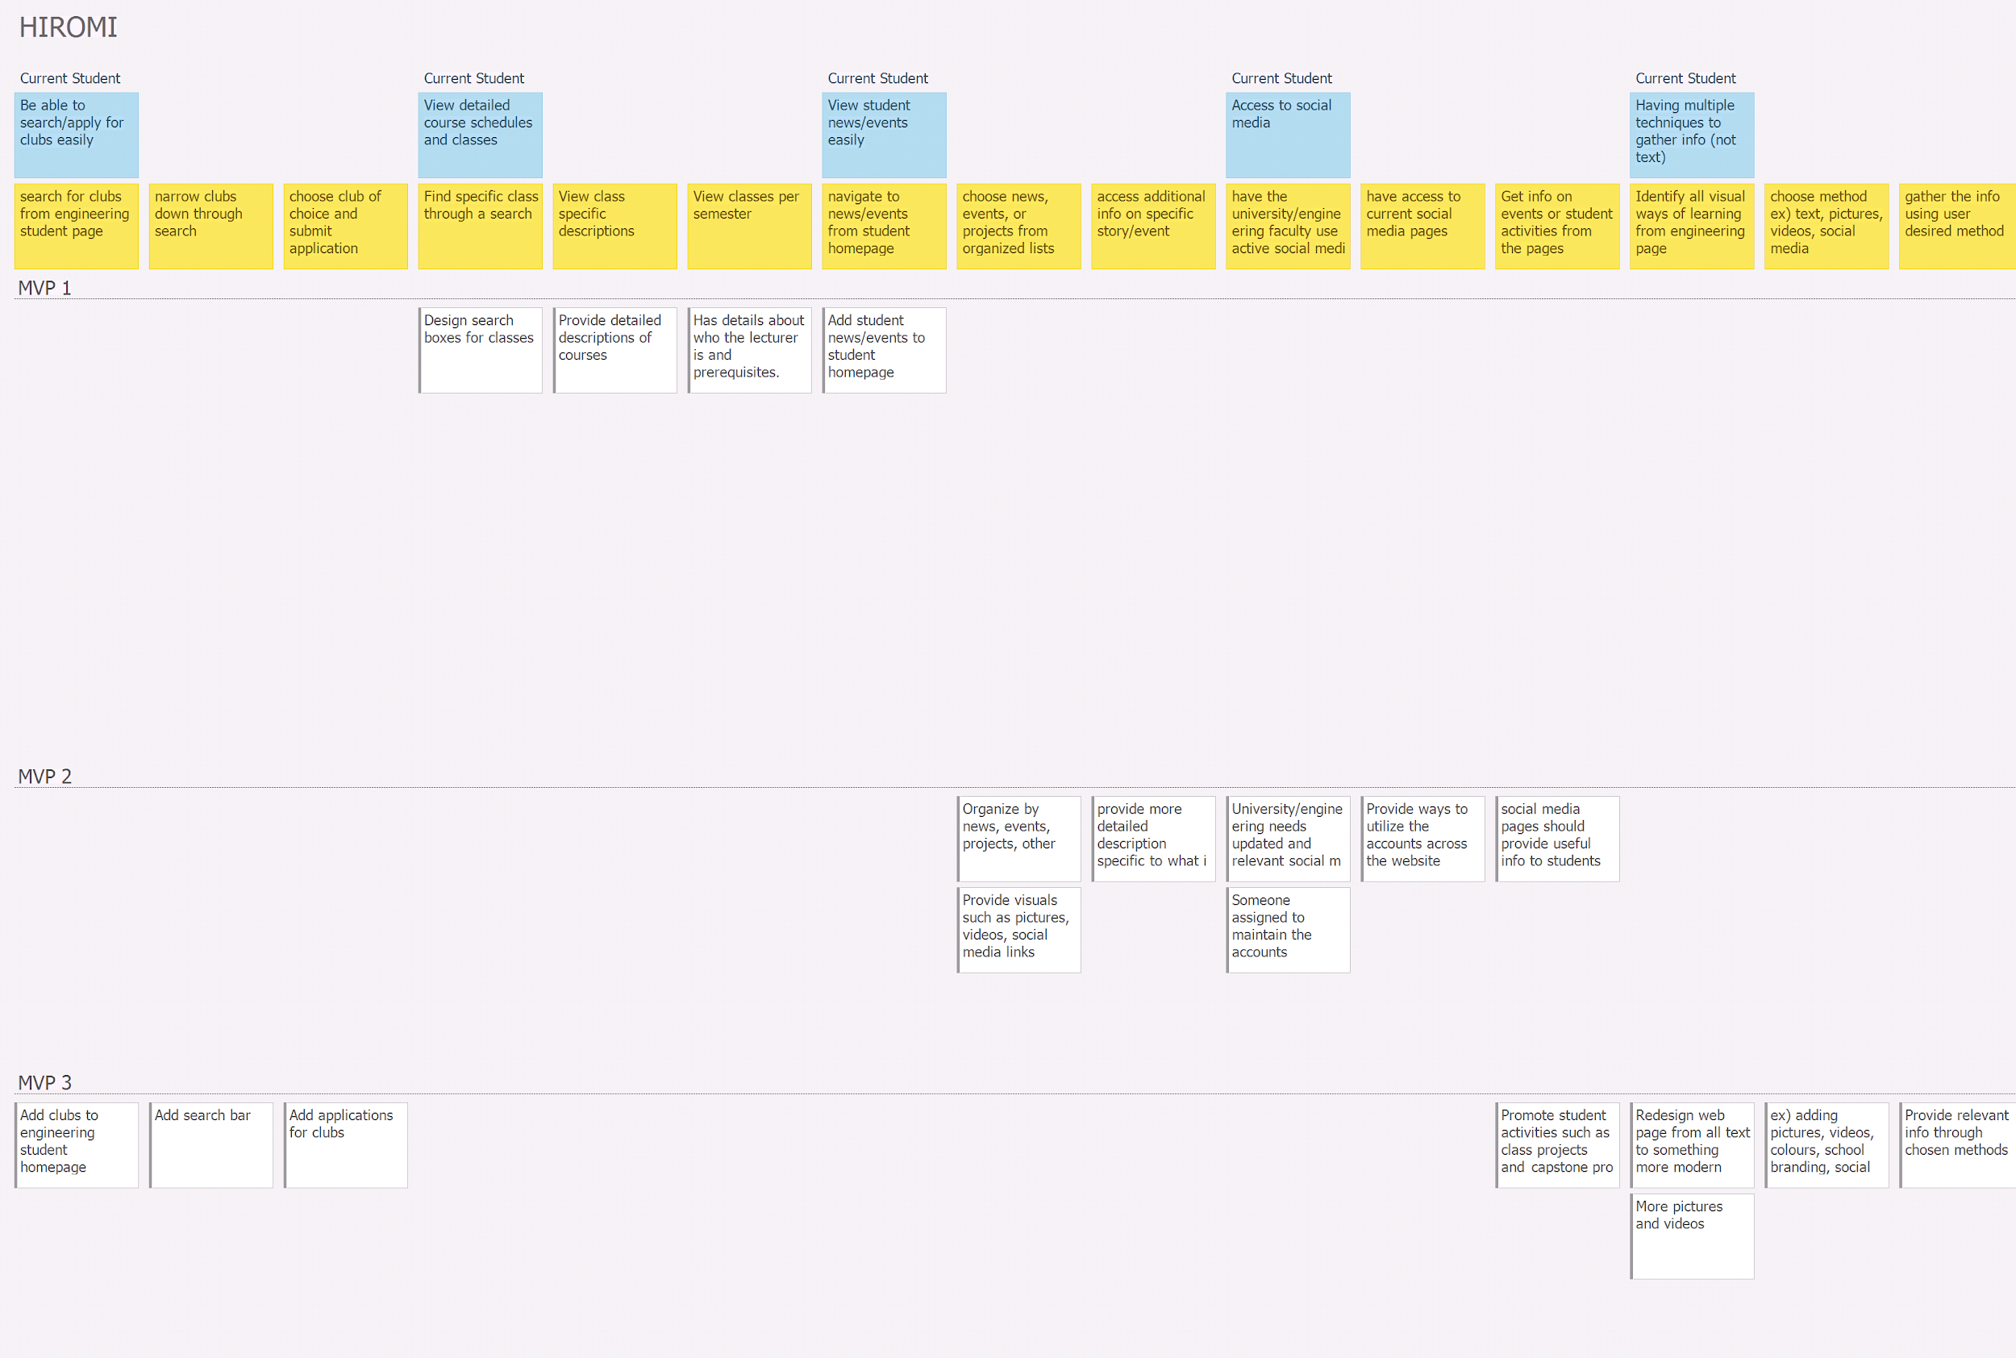
Brainstorm #2: USM and MVP Review

Slide 17
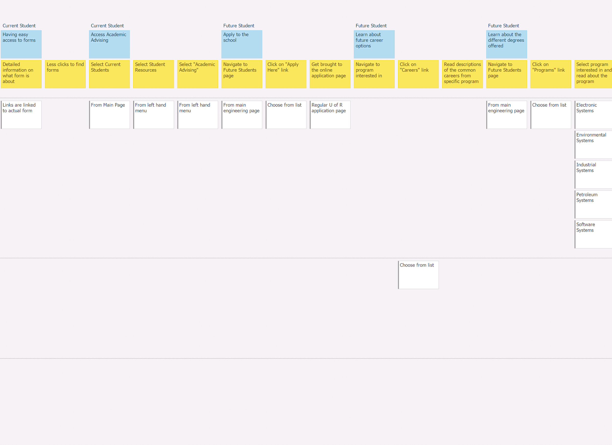
Brainstorm #2: USM and MVP Review

Slide 18
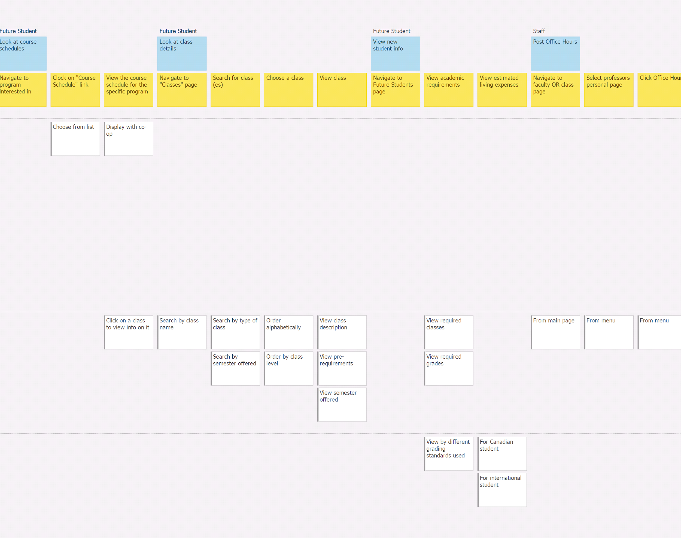
Brainstorm #2: USM and MVP Review

Slide 19
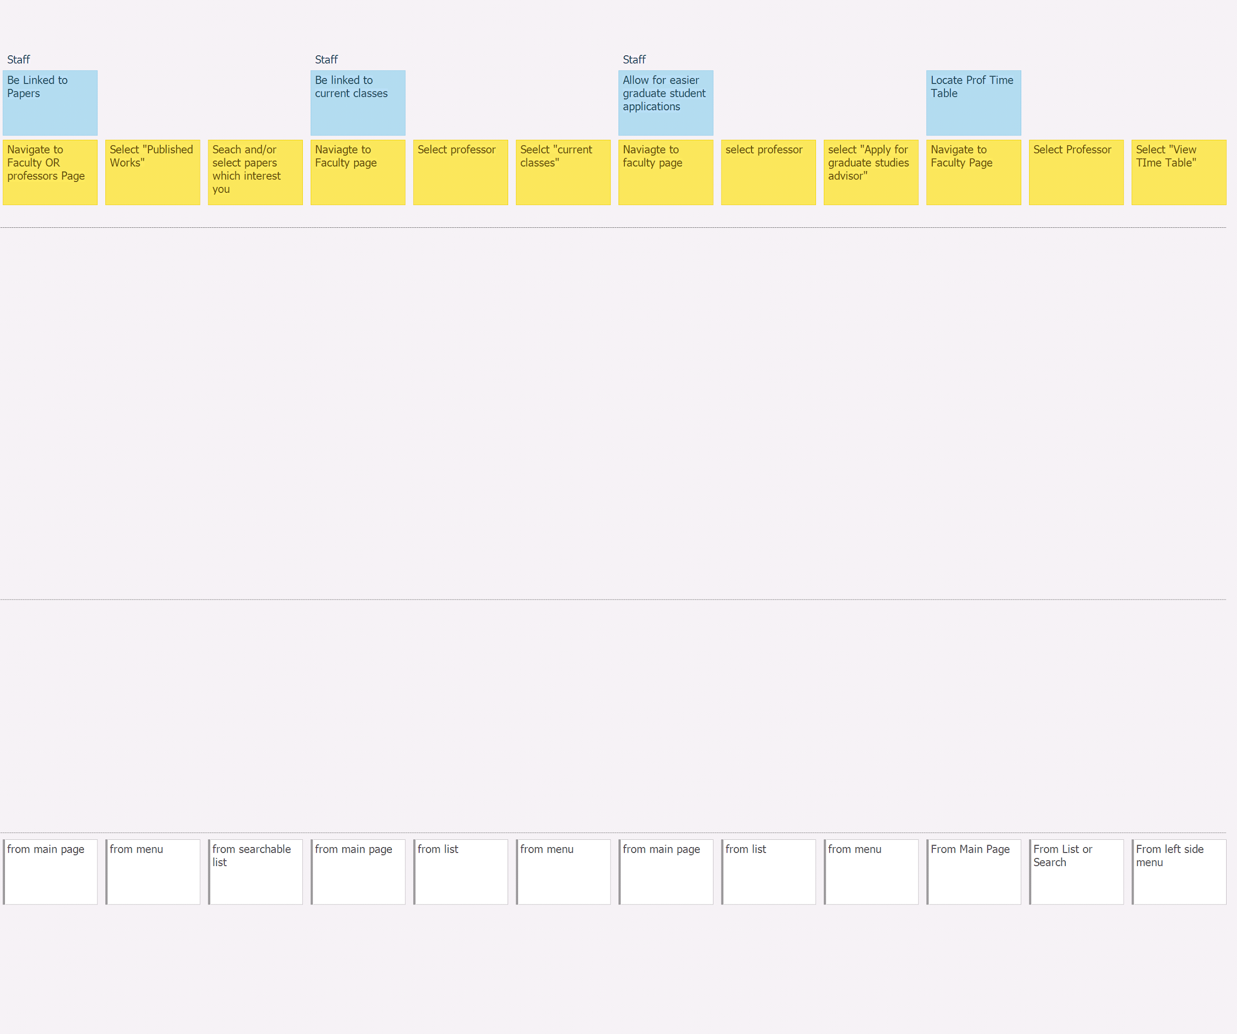
Brainstorm #2: USM and MVP Review

Slide 20
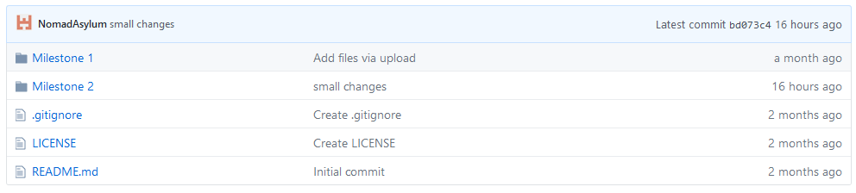
GitHub review
Discuss structure and flow

Slide 21
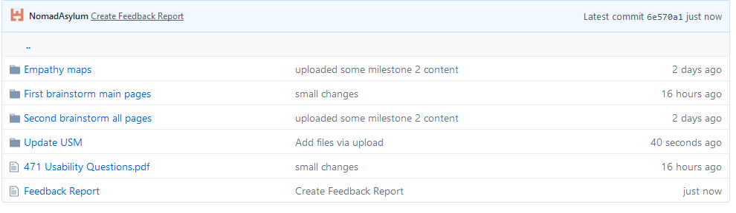
GitHub review
Comment on discoverability and understandability

Slide 22
Group reflection
How did you feel about this milestone? What did you like about it? What did you dislike?
We feel this was another strong milestone. We liked the additional time with stakeholders and that it was one on one, but we disliked the limited amount of time we had with them. We also liked that this was an iterative process, allowing us to hone in on our design.
What did you learn about yourself as you collaborated and worked through this milestone?
We learnt that, generally, we prefer doing lo-fi sketches opposed to storyboarding.
How will you use what you have learned going forward?
The cyclic design process we used will be very beneficial in many projects going forward, even if the process is sped up, this is a useful way to quickly cut to the true desires of a stakeholder.
What “stuff & things” related to this milestone would you want help with?
We feel that anything we would’ve wanted help we, it was provided already.

